Slide 1

StudyCloud: A Cloud-Native Peer Tutoring & Collaboration Platform
Scalable Microservices Deployment on AWS
Areeba Shahbaz & Hazira Azam
Supervisor: Sir Zunnurain Hussain
Teaching Assitant: Sir Umair Makdoom

Slide 2

The Problem Statement
Lack of centralized platforms for students to find peer tutors.
Difficulty in organizing real-time study groups.
Traditional monolithic apps suffer from downtime during updates.
Scaling issues during exam seasons (high traffic).

Slide 3

The Solution (StudyCloud)
Microservices Architecture: Independent services for Auth, Groups, and Tutoring.
Automated Deployment: CI/CD pipeline for zero-downtime updates.
Cloud-Native: Built specifically for AWS to ensure 99.9% availability.
Secure: Private database and isolated networking.

Slide 4
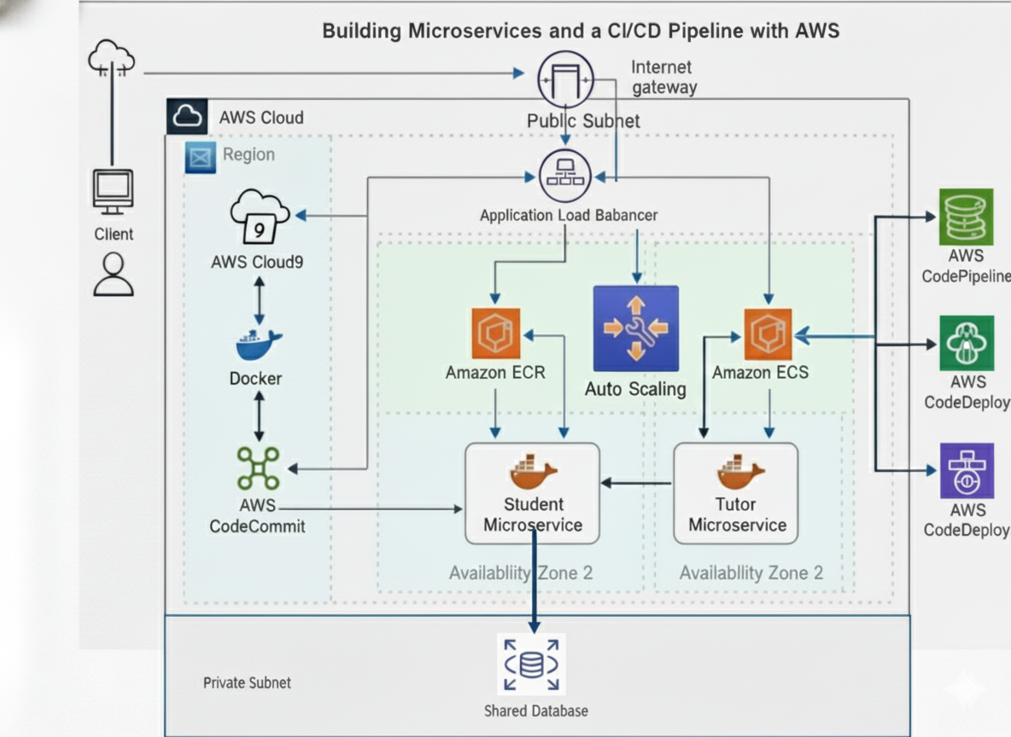
System Architecture (Networking)

Slide 5
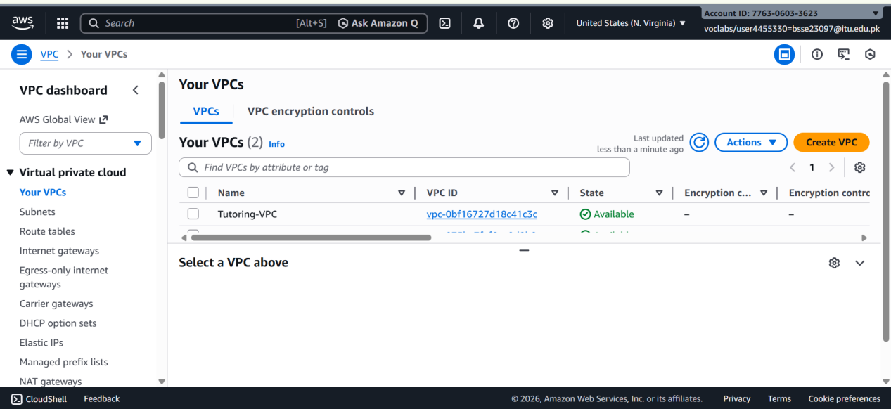
Technical Details: Custom VPC, 4 Subnets (Public/Private), and DNS support.

Slide 6
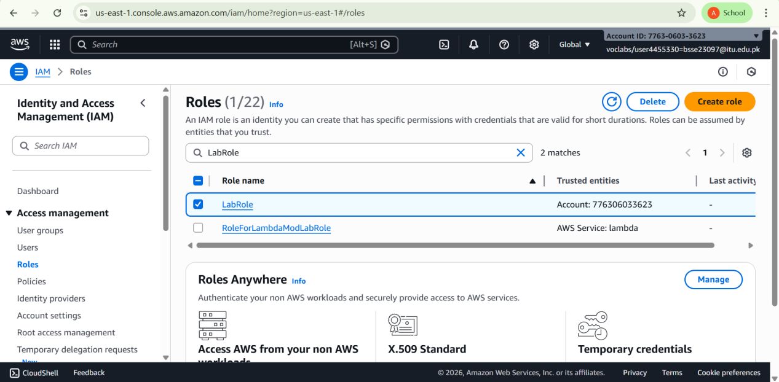
Database & Security IAM roles for security and relational schema for data integrity.

Slide 7
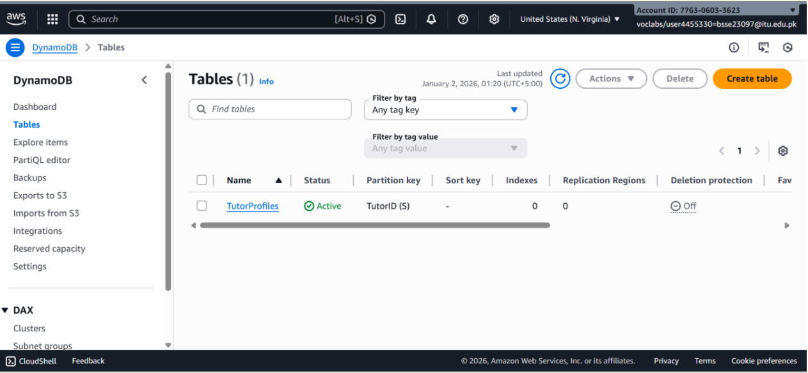
Amazon RDS (Relational Database Service) setup.

Slide 8
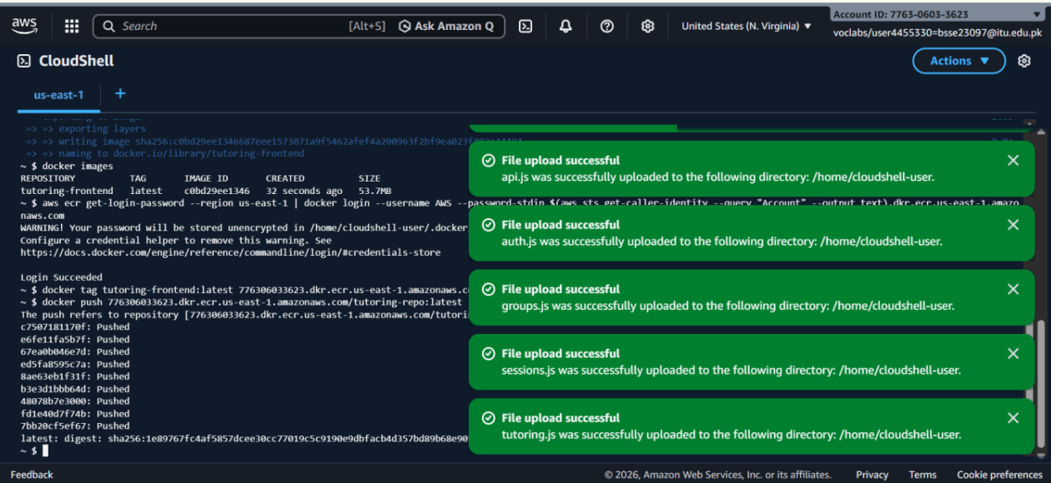
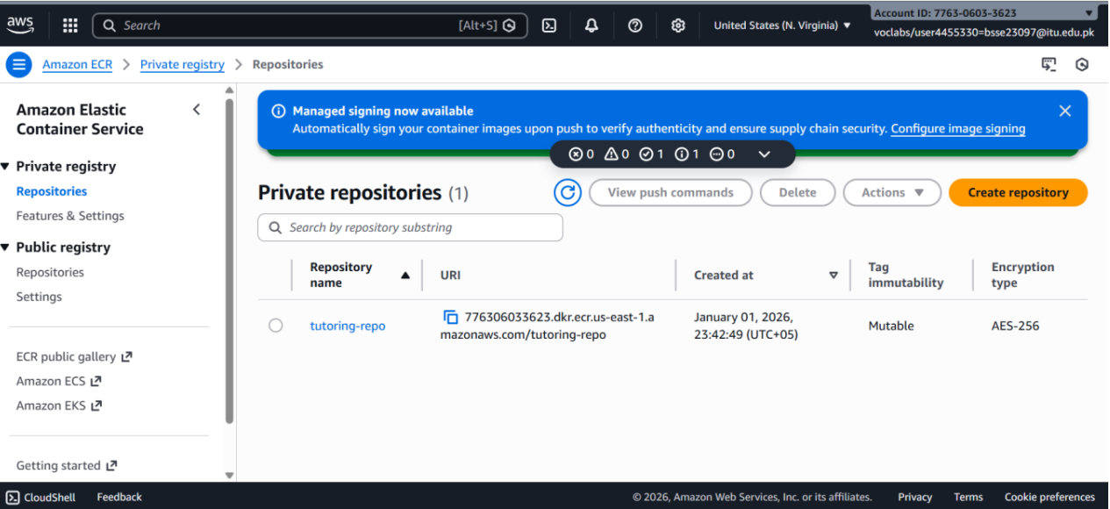
Containerization Strategy
Moving from local code to Docker containers.
Creating Dockerfiles, building images, and pushing to Amazon ECR.

Slide 9
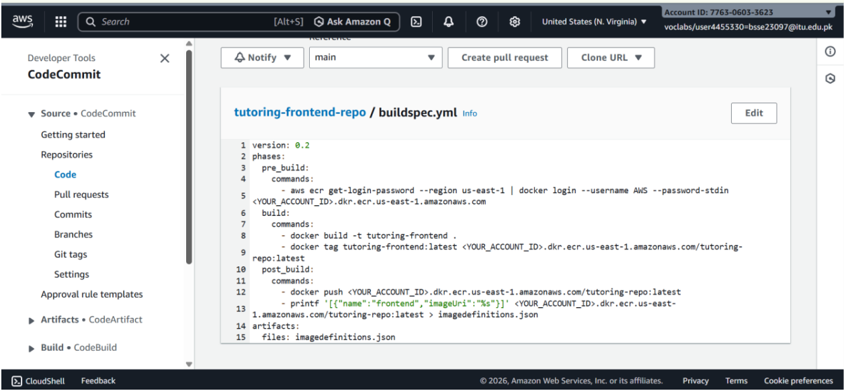
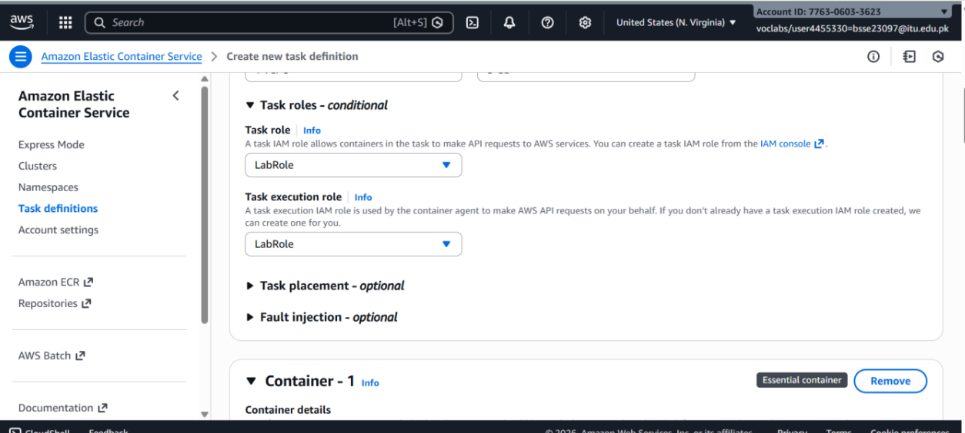
Orchestration with Amazon ECS
Managing containers with ECS Fargate (Serverless).
Task Definitions (CPU/RAM allocation) and Cluster management.

Slide 10
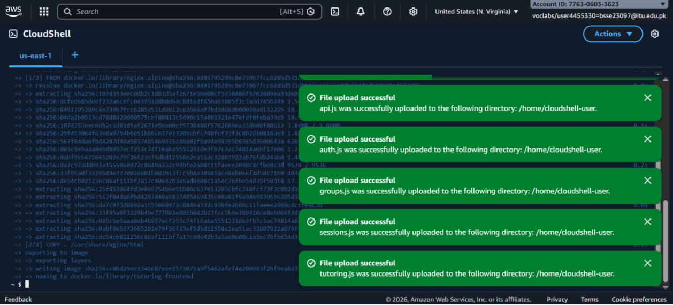
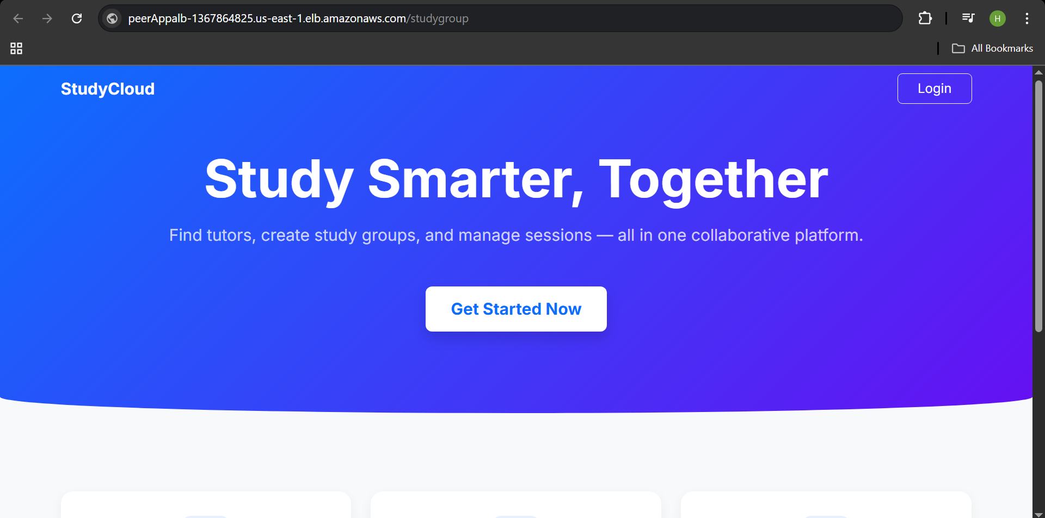
CI/CD Pipeline & Blue-Green Deployment
How we update the app without the user noticing.
Tools: GitHub -> CodeBuild -> CodeDeploy.
Strategy: Blue-Green swap (Traffic shifts from old version to new version).

Slide 11
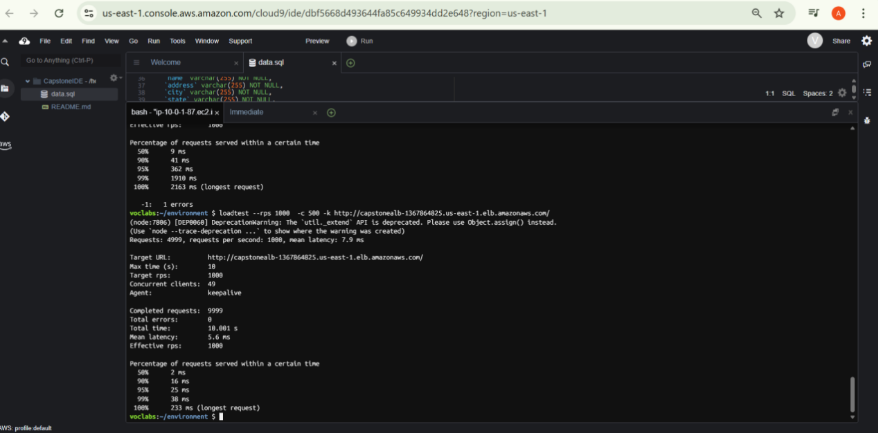
Load Testing & Reliability
Proving the system can handle many users.
Result: Application Load Balancer successfully distributed traffic to healthy targets.

Slide 12
Final Deployment with ALB link

Slide 13

Future Enhancements
Integration of AI for tutor-student matching.
Infrastructure as Code (IaC) using Terraform.
Enhanced security using AWS WAF (Web Application Firewall).
Mobile application development.

Slide 14
Conclusion
"StudyCloud successfully bridges the gap between students and tutors using modern DevOps practices."
"Thank you! Any Questions?"

